Slide 1

ReactOS
Une alternative libre et gratuite à Windows
Pierre Schweitzer – https://www.reactos.org – pierre@reactos.org
Notes:
Quick intro – 30s
Hello, my name is Aleksey Bragin, I am coordinator of and developer for ReactOS project.
In this talk I’m going to give you a brief overview of ReactOS, components it consists of, technical aspects of the kernel and the bootloader, and perform a small demonstration of what ReactOS really is.

Slide 2

About the speaker
Pierre Schweitzer:
  pierre@reactos.org, @HeisSpiter
  ReactOS Developer since November 2007
  ReactOS sysadmin & netadmin since July 2011
  Using nicknames: Heis Spiter, pschweitzer
  GPG: 0x3D585B0B
Notes:
All – 300 sec
1 - What is ReactOS? – 10 sec
2 – History – 180 sec
Back in the 1970’s and 80’s, the dominant operating system was Unix. However Unix was costly, and out of the reach of your average home user.
In the early 90’s, a computer science student named Linus Torvalds, who was fascinated by hardware and operating systems started a project to rewrite the Unix kernel.
His progress was documented online and quickly aroused the interest of other developers. Development on this free version of Unix grew into what many of you know today as Linux. A dominant presence in the server market, and a potential threat to Windows in the client market.
However, this potential domination in the client market has never really taken hold as the major Linux players continually hope for. Therefore, there is still a huge niche in the market with Microsoft maintaining their stranglehold on end users, at the users cost. This is where ReactOS comes in, with an aim to do with Windows what Linux did with Unix.
ReactOS originally emerged as FreeWin95, encouraged by the growth of Linux, its goal was to write a free implementation of Windows 95. The original project didn’t get very far. There was too much talk about methodologies and not enough coding and it eventually withered away.
In 1997, one of the FreeWin95 developers put out a call out to regroup with a new goal of Windows NT, and an emphasis on writing code as opposed to emails. A new name was decided upon as a reaction to the Windows domination, and ReactOS was born.
The initial years were painfully slow. Low level coding of the kernel mode components was left to specialist developers. With no eye-candy to show to the world, the project remained relatively unknown making it difficult to attract new developers. Initial foundations for the NT kernel and HAL were put in place, and basic generic drivers were written, paving the way for the beginnings of a new operating system.
3 – Complete Windows replacement – 20 sec
ReactOS is an effort to produce a complete rewrite of the Windows NT5 operating system. Thus, ReactOS is not Linux based, but a completely new operating system.
The whole operating system is being written from the ground up, with the entire architecture simulating the NT5 architecture.
We believe most home users are so used to Windows and have become so reliant on it, that a move to a completely different operating system is simply out of the question. There is also the fact that the majority of home users simply don’t have the necessary computer skills to run Linux, or a desire to learn it.
Whilst Linux only provides a kernel with all the other components available as add-ons, ReactOS is a full operating system distribution as Windows is. This means it will not only include system architecture above the kernel, but also apps such as Explorer, Notepad and a paint package.
4 - 100% compatible with Windows – 20 sec
The aim of ReactOS is to take any Windows software off the shelf, and have it successfully install and run in ReactOS. This doesn’t just apply to software such as MS Office or Photoshop, but also applies to games and even drivers.
5 – Licensed under the GPL – 20 sec
The majority of the ReactOS codebase is licensed under the GPL. This means the full source code is available online, and freely available for anyone to download and modify at their leisure. Some parts of the source which have been incorporated from projects such as Wine or BSD are licensed according to their project.
6 – ~20 active developers – 20 sec
Our central code repository is located in Russia and is controlled via a CVS system called SVN. We have active developers from Europe, America and Canada working on ReactOS, and a strong list of contributors from all around the world.
7 – Freely available to everyone – 20 sec
Being that ReactOS is licensed under the GPL, it ensures it will always be freely available, both as in speech, and as in beer.

Slide 3
What is ReactOS?
Free & Open Source Operating System
  https://www.reactos.org
Reimplementing the Windows API
  Aiming Windows 2k3 compatibility
Latest release: 0.3.16
Alpha stage
Notes:
All – 240 sec
Let's take a look at the key system components that make up its architecture.
A simplified version of this architecture is shown, keep in mind that this diagram is basic, it doesn't show everything. (For example, the networking components and the various types of device driver layering are not shown.)
The four basic types of user-mode processes are described as follows:
Fixed system support processes such as the logon process and the session manager, that are not Windows services. (That is, they are not started by the service control manager)
Service processes that host Windows services, such as the Task Scheduler and Spooler services. Services generally have the requirement that they run independently of user logons. Many Windows server applications, such as Microsoft SQL Server and Microsoft Exchange Server, also include components that run as services.
User applications, dealing with 32 only at present with ReactOS
Environment subsystem server processes, which implement part of the support for the operating system environment, or personality presented to the user and programmer. Windows NT originally shipped with three environment subsystems: Windows, POSIX, and OS/2. OS/2 was dropped as of Windows 2000. As of Windows XP, only the Windows subsystem is shipped in the base product—an enhanced POSIX subsystem is available as part of the free Services for Unix product.
Notice the "Subsystem DLLs" box below the "Service processes" and "User applications" boxes. Under Windows, user applications don't call the native Windows operating system services directly; rather, they go through one or more dlls. The role of the subsystem DLLs is to translate a documented function into the appropriate internal (and generally undocumented) Windows system service calls. This translation might or might not involve sending a message to the environment subsystem process that is serving the user application.
The kernel-mode components of Windows include the following:
The Windows executive contains the base operating system services, such as memory management, process and thread management, security, I/O, networking, and interprocess communication.
The Windows kernel consists of low-level operating system functions, such as thread scheduling, interrupt and exception dispatching, and multiprocessor synchronization. It also provides a set of routines and basic objects that the rest of the executive uses to implement higher-level constructs.
Device drivers include both hardware device drivers that translate user I/O function calls into specific hardware device I/O requests as well as file system and network drivers.
The HAL is a layer of code that isolates the kernel, device drivers, and the rest of the Windows executive from platform-specific hardware differences (such as differences between motherboards).
The windowing and graphics system implements the graphical user interface (GUI) functions (better known as the Windows USER and GDI functions), such as dealing with windows, user interface controls, and drawing.

Slide 4
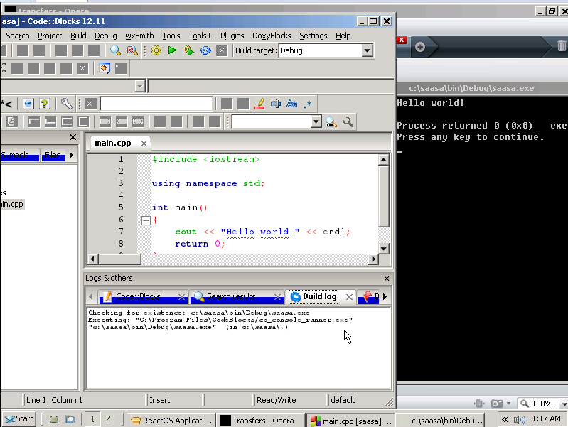
One Picture
Notes:
All – 20 sec
Ok, I’m gonna move away from the architecture design, and speak about key components which the majority of people are interested in, and the state of these components in ReactOS.
Executive, including HAL, Kernel and device drivers
Win32 subsystem, comprising of both kernel and usermode components
The network model, from layer 2 to layer 7
GDI, windowing and the user interface
Gaming, provided by both DirectX and OpenGL.

Slide 5
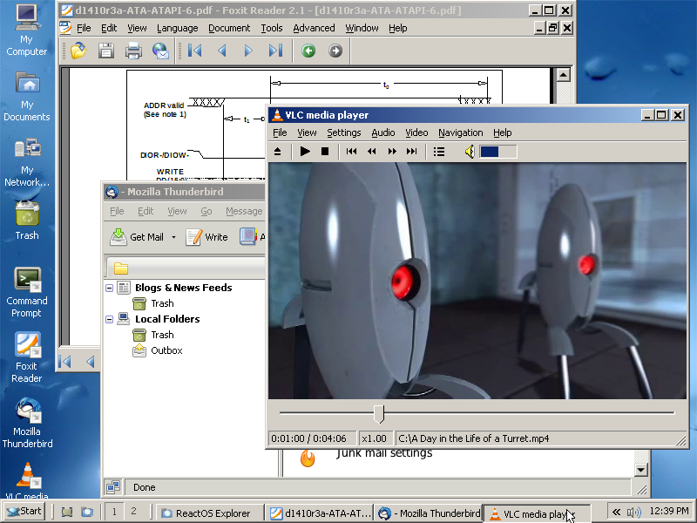
A Second one
Notes:
All – 20 sec
Ok, I’m gonna move away from the architecture design, and speak about key components which the majority of people are interested in, and the state of these components in ReactOS.
Executive, including HAL, Kernel and device drivers
Win32 subsystem, comprising of both kernel and usermode components
The network model, from layer 2 to layer 7
GDI, windowing and the user interface
Gaming, provided by both DirectX and OpenGL.

Slide 6
Purposes of ReactOS?
Free Windows!
Want to look at code?
Have to stay on an old maintained Windows?
Want to modify your own Windows?

Slide 7
Collaboration with FOSS world
Using Wine code
Cross-compilation with MinGW-w64
Usage of CMake, ninja, and so on

Slide 8
Collaboration with Wine
Usage of their DLLs
But also of their compilation tools
Usage of their tests
We provide patches & bugs

Slide 9
ReactOS is not Wine
Kernel implementation
Drivers implementation
Support of Windows drivers
No need for Linux

Slide 10
Development process
Usage of tests (Wine, home-made)
Usage of documentation (MSDN)
Usage of books (Windows Internals, ...)
Usage of others findings

Slide 11
Current status
Architectures: x86, (AMD64, ARM7)
Networking, basic sound, basic USB
Some drivers for Windows reported to work
Lack of proper Memory Manager

Slide 12
Actively worked parts
Ntvdm: 16 bits on Windows!
Shell: rewrite of our old shell (explorer)
  We have a half-time paid dev
USB
File system

Slide 13
Perception for end-users
Several key apps working
Firefox, 7z, even games!
Unstable though
http://reactos.reactos.org

Slide 14
Some dates...
Project exists since 1998!
  In 1996, it was FreeWin95
2004, 0.2 released. Comes with GUI
2006, 0.3 released. Comes with network
2009, 0.3.9 released. Sound!
2013, 0.3.15 released. USB!

Slide 15
Some digits...
More than 230k downloads for 0.3.16
  Was released in February 2014
Over the year:
  More than 3400 commits
  More than 20 commiters
Around 5 millions LoC (trunk)
Around 10 millions tests

Slide 16
Dark side!
Several builders
Several testbots
Infrastructure of 6 servers (+ Vms)
ReactOS Foundation & ReactOS Deutschland e.V.
1 half-time paid developer

Slide 17
ReactOS CE
Community Edition
Founded via IndieGoGo
Will bring ReactOS to 0.4
With priorities defined by the community

Slide 18
We need...
Testers
Developers
  GUI, kernel, drivers, DLLs, everywhere!
Translators
Propose, we're likely to need you
Money…

Slide 19
Join us!
Website: https://www.reactos.org
IRC: #reactos on Freenode
Mailing-list: ros-dev@reactos.org
We enjoy new people :-)

Slide 20
Demonstration
Questions?
Notes:
Question time!
A demonstration of ReactOS!

